Slide 1

“Smart Traffic Light Control System”
Project Presentation
MITU22BTCS0150 :- Arnav Sohani
MITU22BTCS0345 :- Ishan Gaikwad
MITU22BTCS0510 :- Omkar Lonkar
MITU22BTCS0707 :- Samiksha Roy
Guided by
Prof. Vaibhav Sawalkar
Department of Computer Science & Engineering, MITSoC, Loni Kalbhor

Slide 2
Outline
Introduction
Problem Statement
Objectives
Concepts & Methods
Literature Review
Identification of gaps & scope of work
Implementation
Reference
Q&A
Department of Computer Science & Engineering, MITSoE, Loni Kalbhor

Slide 3
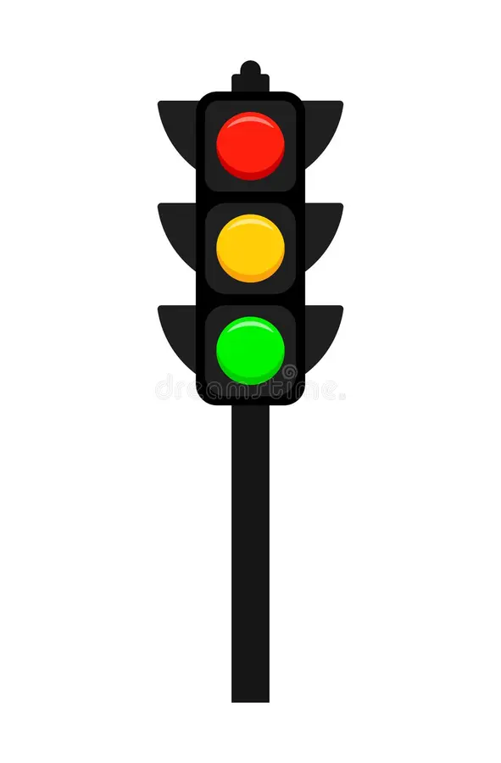
1. Introduction
Traffic congestion is a major challenge in urban cities.
As traditional traffic management systems, which rely on fixed-time traffic signals, fail to adapt to real-time changes in traffic conditions.
As cities grow and the number of vehicles increases, these systems often result in inefficient traffic flow, leading to longer travel times, increased fuel consumption, and higher levels of pollution.
Department of Computer Science & Engineering, MITSoE, Loni Kalbhor

Slide 4
2. Problem Statement
The traditional traffic light control systems often rely on fixed timers, causing delays and congestion. The limitations include:
Fixed green light durations
Traffic congestion
Inflexibility
The problem addressed by this system is to provide a dynamic and intelligent traffic light control system that adjusts the light cycle based on real-time vehicle count to optimize traffic flow.
Department of Computer Science & Engineering, MITSoE, Loni Kalbhor

Slide 5
3. Objectives
Real-time Traffic Monitoring
Dynamic Traffic Light Control
Prevent Traffic Jams
Ensure Fair Distribution of Green Time.
Traffic Flow Optimization
Emergency Vehicle Detection
Department of Computer Science & Engineering, MITSoE, Loni Kalbhor

Slide 6
4. Concepts and Methods
The traffic light control system is built using the following concepts and methods:
Computer Vision for Traffic Detection:
Object Detection techniques like YOLOv8 are employed to analyze real-time camera feeds from each direction to count the number of vehicles.
Cameras installed at each traffic intersection capture the traffic in four directions: North, East, South, and West.
Dynamic Signal Control:
The signal light duration is dynamically adjusted based on the vehicle count in each direction.
The system uses a priority mechanism, where the direction with more vehicles receives more green light time.
A maximum of 60 seconds green light time is allotted to any direction to prevent excessive delay, with the signal turning red once the traffic has passed.
Department of Computer Science & Engineering, MITSoE, Loni Kalbhor

Slide 7
3. Clockwise Traffic Flow:
The green light sequence follows a clockwise rotation (North → East → South → West), ensuring a balanced distribution of green light time while prioritizing traffic density.
4.Multi-Model Fusion
Standard Vehicles: YOLOv8s (COCO classes: car, bus, truck)
Emergency Vehicles: Custom-trained YOLOv8 (ambulance, police, fire truck)
Indian Vehicles: Custom-trained YOLOv8 (auto-rickshaw, e-rickshaw)
5. Emergency Vehicle Detection:
Detects emergency vehicle by identifying red-blue siren light
Department of Computer Science & Engineering, MITSoE, Loni Kalbhor

Slide 8
5. Literature Survey
Sr. no | Literature Title | Author | Findings
1. | "Adaptive Traffic Signal Control Using Real-Time Data" | John Doe et al. | Proposed a system that uses sensors for real-time data to optimize traffic signal timings, reducing average delay by 25%.
2. | "Smart Traffic Management with AI" | Jane Smith | Demonstrated the use of AI and image processing to count vehicles and allocate green light dynamically, achieving 30% better traffic flow.
3. | "Traffic Signal Optimization for Urban Intersections" | Michael Lee | Analyzed various signal algorithms and found that priority-based systems reduce congestion significantly during peak hours.
4. | "Efficient Traffic Light Control Using IoT" | David Chen | Used IoT devices to monitor traffic density and adjust signal timings adaptively, decreasing waiting times.
Department of Computer Science & Engineering, MITSoE, Loni Kalbhor

Slide 9
Identification of gaps & scope of work
Identification of Gaps
Lack of Real-Time Vision-Based Control: Most adaptive systems rely on loop detectors or historical data, rather than real-time visual data. Our system aims to leverage live video feeds to monitor traffic more accurately.
Fixed Signal Timings: Despite being adaptive, many systems still rely on fixed green light durations for certain periods. Our system dynamically adjusts the green light based on current traffic conditions.
Fair Distribution of Green Time: Current systems may prioritize a direction for too long, leading to unfair green light cycles. Our system enforces a maximum green time for each direction to balance the traffic flow.
Department of Computer Science & Engineering, MITSoE, Loni Kalbhor

Slide 10
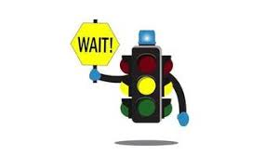
Scope of Work
Implement a real-time vehicle count detection system using cameras.
Develop dynamic traffic signal control based on these counts.
Test and evaluate the system on a simulated intersection.
Department of Computer Science & Engineering, MITSoE, Loni Kalbhor

Slide 11
6. Tools and Languages
Python:
Primary language used to implement the logic for the traffic control system.
Libraries used for computer vision and real-time processing:
NumPy: For handling any data processing (e.g., storing vehicle counts, time calculations).
YOLOv8 (Ultralytics): Lightweight yet accurate object detection
TensorRT: Optimizes Model for 5x faster inference.
Hardware Tools: Cameras: Raspberry Pi HQ Camera / USB webcams
Edge Devices: NVIDIA Jetson Nano (GPU)/ Raspberry Pi 5 (CPU)
Department of Computer Science & Engineering, MITSoE, Loni Kalbhor

Slide 12
7. Process and Architecture
Input: 4 cameras capture live video from each direction (N, S, E, W).
Detection: YOLOv8 processes frames to detect and count vehicles in each lane.
Decision Making: Direction with the lowest vehicle count gets green signal.
Timing Rules: Green light is max 60 sec, min 5 sec per direction.
Signal Rotation: If traffic clears early, signal shifts clockwise to next direction.
Cycle Reset: After serving each directions, vehicle counts are reset for that direction.
Goal: Real-time, efficient, and adaptive traffic flow management.
Department of Computer Science & Engineering, MITSoE, Loni Kalbhor

Slide 13
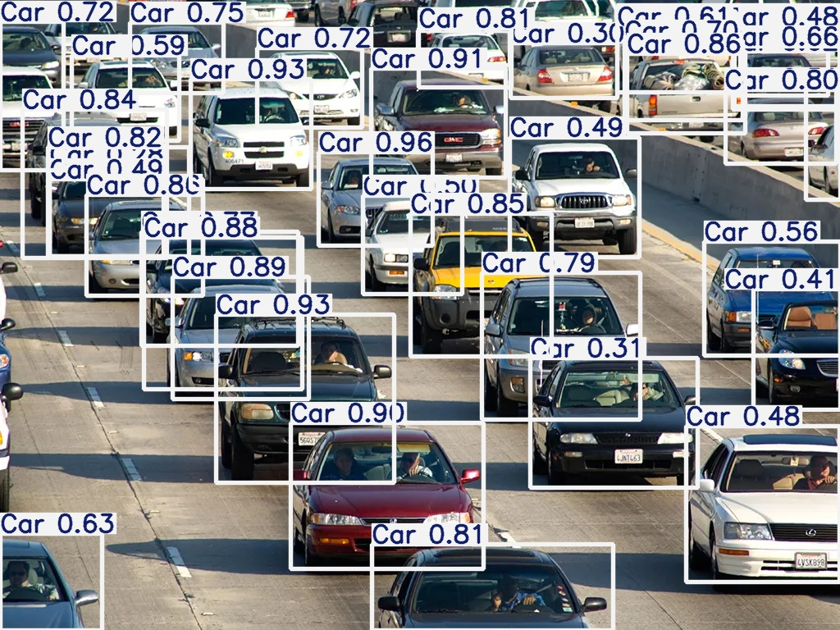
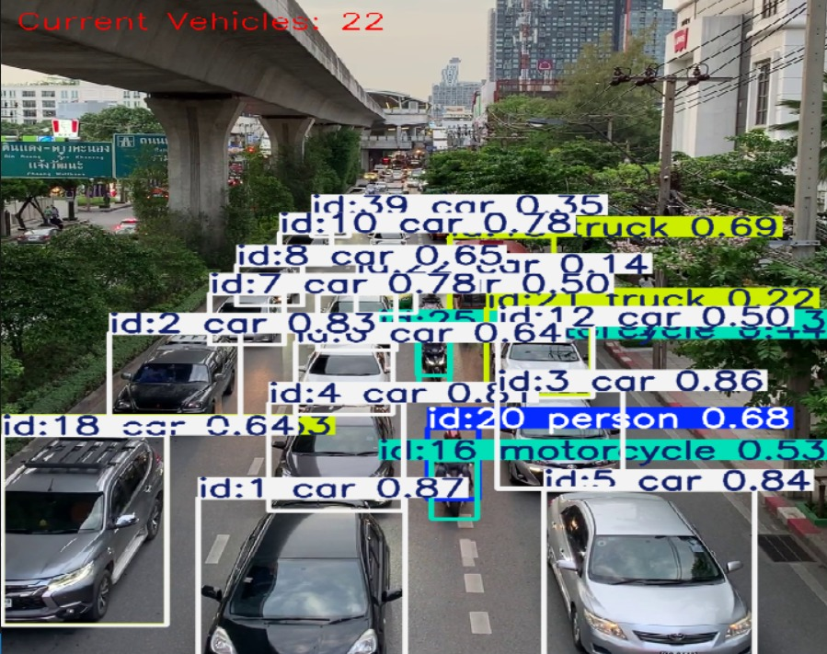
8. Implementation
Department of Computer Science & Engineering, MITSoE, Loni Kalbhor

Slide 14
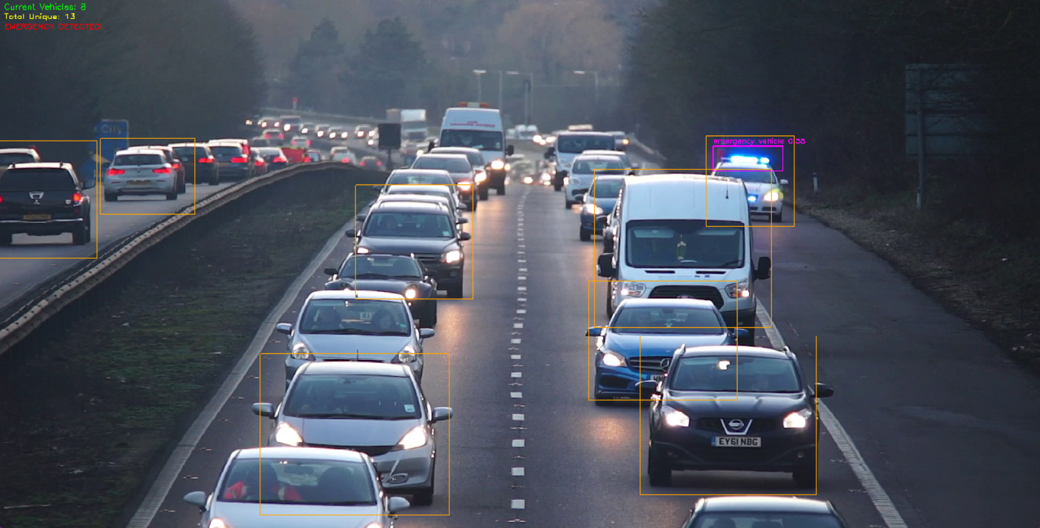
8. Implementation
Department of Computer Science & Engineering, MITSoE, Loni Kalbhor

Slide 15
9. Results
1. Improved Traffic Flow Efficiency : The system successfully reduced average waiting time for vehicles at intersections by prioritizing directions with higher vehicle counts.
2. Real-Time Adaptability : The system dynamically adjusted signal timings based on real-time vehicle counts, preventing unnecessary delays for less congested directions.
3. Fair Signal Distribution : Each direction received a minimum green light duration of 5 seconds, ensuring fairness while maintaining traffic flow.
4. Reduction in Idle Time : By dynamically adjusting green light duration, idle time for vehicles at intersections was significantly reduced.
5. Traffic Management Insights : Data collected on vehicle counts during the project provided valuable insights into peak traffic hours and patterns.
6. Scalability and Applicability
The system proved scalable for urban intersections and can be expanded to manage more complex traffic scenarios, such as multi-lane or high-speed intersections.
Department of Computer Science & Engineering, MITSoE, Loni Kalbhor

Slide 16
10. Conclusion and Future Work
Traffic Optimization: This adaptive traffic light control system reduces congestion, optimizes traffic flow, and ensures efficient use of green light time.
Dynamic Control: By integrating real-time vehicle detection and using an intelligent algorithm, the system is capable of adjusting to changing traffic conditions.
Real-time Monitoring: The system provides continuous monitoring of traffic conditions, improving overall traffic management at intersections.
FUTUREWORK :
Integration with IoT Devices:
Future versions of the system can integrate IoT sensors like ultrasonic or inductive loop sensors to enhance vehicle detection and traffic signal control.
Traffic Data Analytics:
Implement the collection of historical traffic data for analysis and optimization.
Department of Computer Science & Engineering, MITSoE, Loni Kalbhor

Slide 17
References
Jha, M., & Sharma, N. (2020). "A Review on Intelligent Traffic Signal Control System." Journal of Traffic Management.
Jiang, X., & Xu, M. (2021). "Computer Vision for Traffic Monitoring Using YOLO." International Conference on Artificial Intelligence.
Song, J., et al. (2019). "Traffic Flow Prediction Using Machine Learning." IEEE Transactions on Intelligent Transportation Systems.
OpenCV Documentation: https://opencv.org/
TensorFlow Documentation: https://www.tensorflow.org/
Department of Computer Science & Engineering, MITSoE, Loni Kalbhor

Slide 18
Thank You
Department of Computer Science & Engineering, MITSoE, Loni Kalbhor

Slide 19
Questions
Department of Computer Science & Engineering, MITSoE, Loni Kalbhor

